Slide 1

NSG Pilkington – University of Liverpool Machine Learning Project: 27/01/2021
Dr. Peter Green
Diego Echeverria
Risk Institute,
School of Engineering

Slide 2
List of activities
Implementation of the strategy to remove the remaining data from the spikes in the Remove Spikes pipeline section.
Test the strategy in both available training datasets.
Introduce Bespoke filtering.
How the relevant inputs change along with the training dataset?
Eliminate the relevant inputs that are correlated and run the model again.

Slide 3
List of activities
Implementation of the strategy to remove the remaining data from the spikes in the Remove Spikes pipeline section.
Test the strategy in both available training datasets.
Introduce Bespoke filtering.
How the relevant inputs change along with the training dataset?
Eliminate the relevant inputs that are correlated and run the model again.

Slide 4
Removal of the potential remaining data from the spikes
When using the data corresponding to the period from ‘21/09/19’ to ‘25/10/19’.
When using the data corresponding to the period from ‘07/03/2020’ to ‘19/03/2020’.

Slide 5
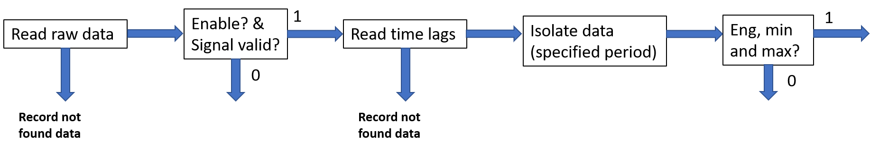
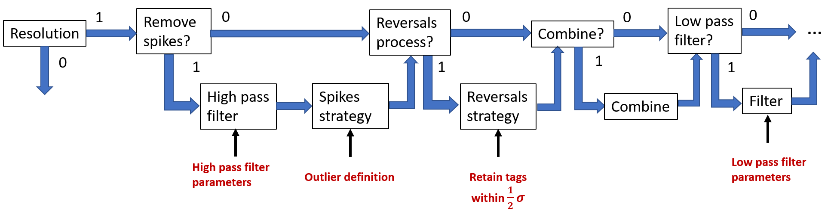
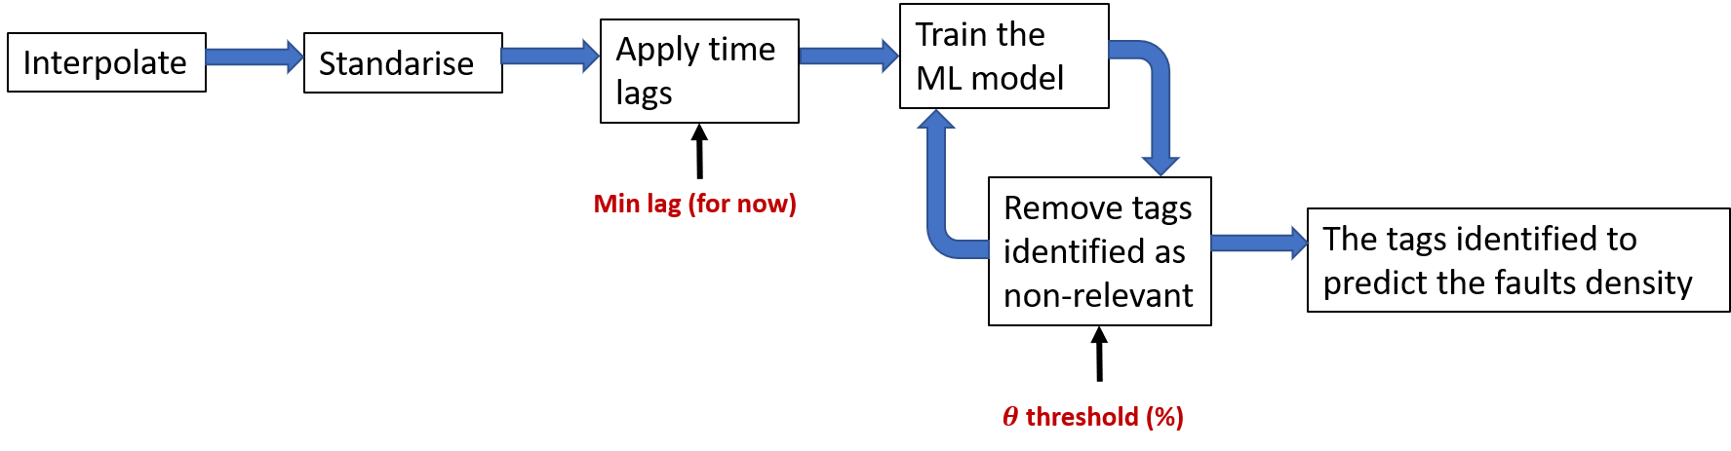

Slide 7
Remaining values definition

Slide 8
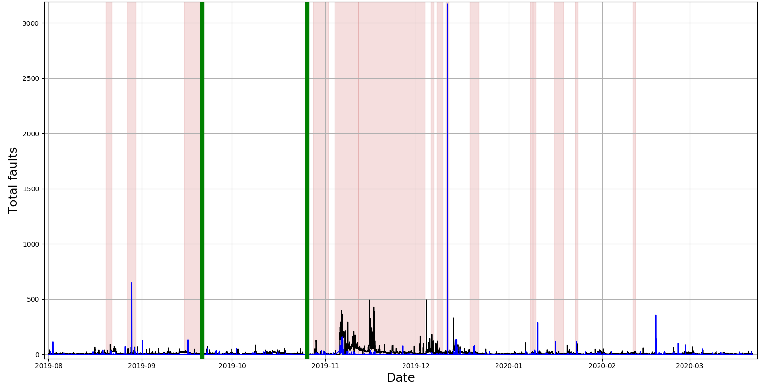
Exclusion Periods: ISRA 5D and MK4 data
Exclusion Periods
ISRA 5D
MK4

Slide 9
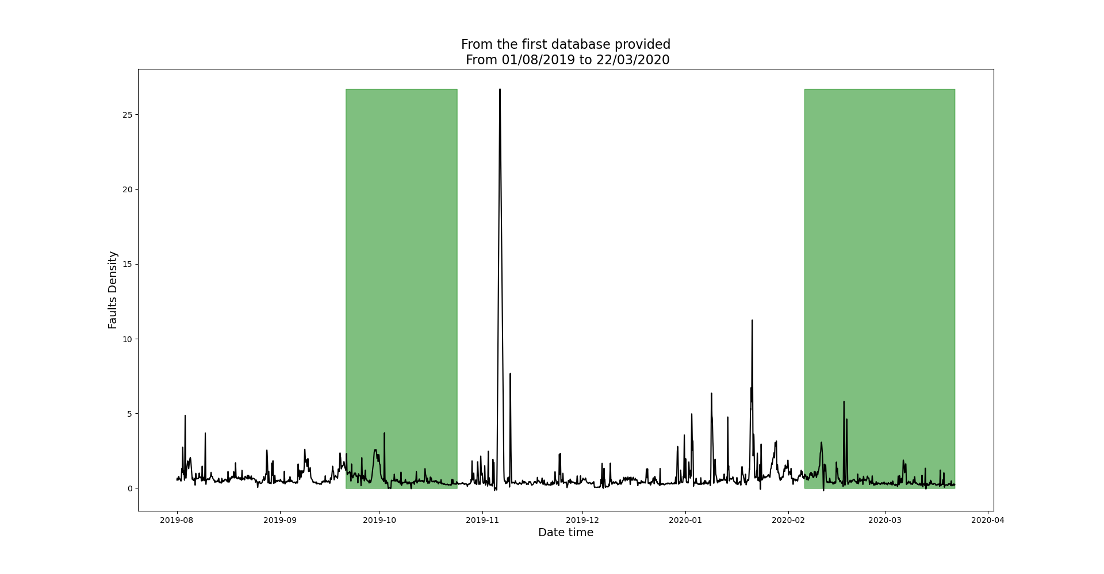
Continuous clean regions: ISRA 5D
Clean regions
ISRA 5D

Slide 10
Testing the removal of the potential remaining data from the spikes
When using the data corresponding to the period from ‘21/09/19’ to ‘25/10/19’.
When using the data corresponding to the period from ‘07/03/2020’ to ‘19/03/2020’.

Slide 11
Continuous clean regions: ISRA 5D
Clean regions
ISRA 5D

Slide 12
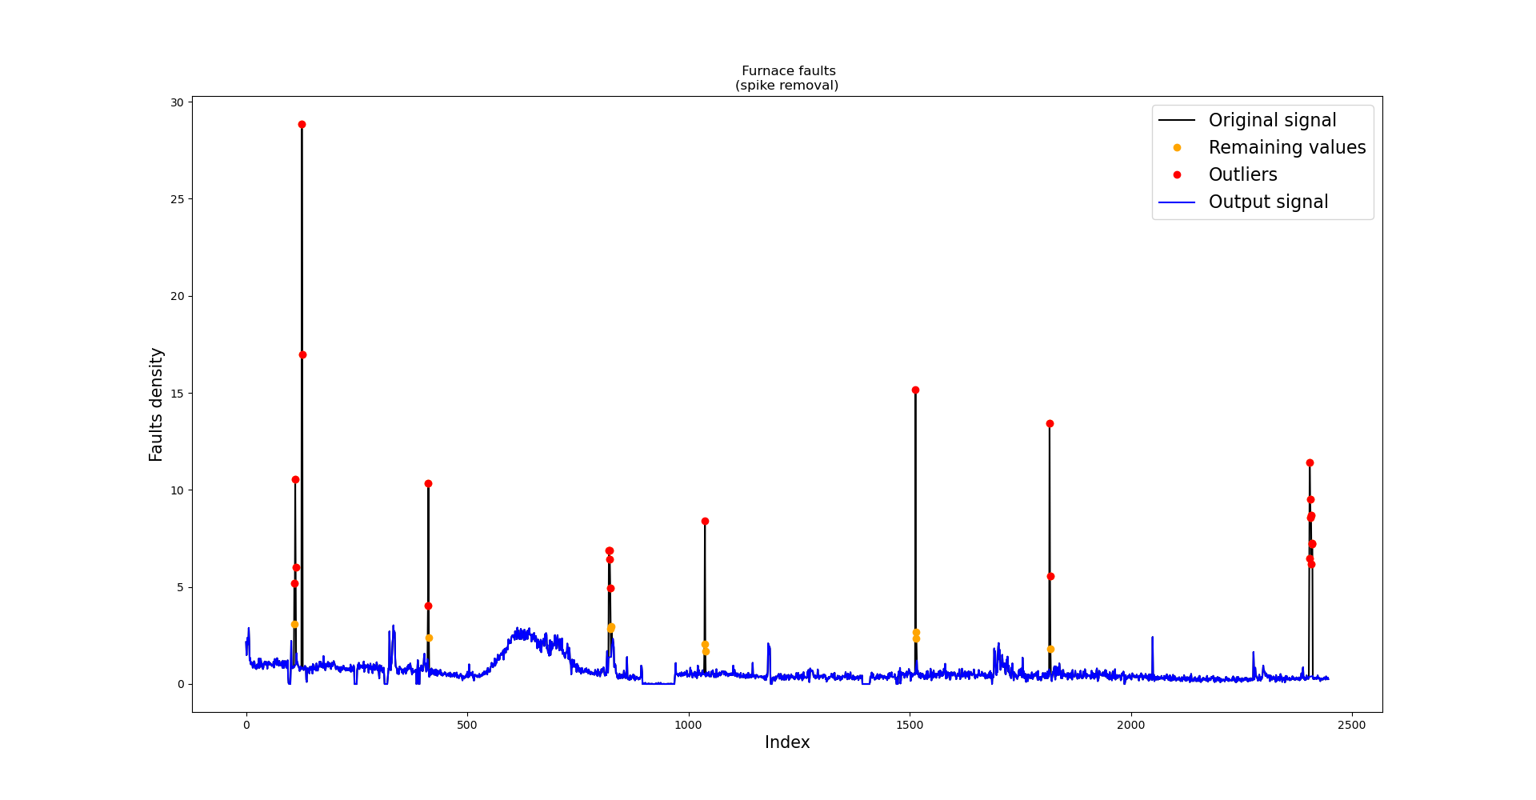
Region 1: High-pass filter, spike definition and remaining values definition

Slide 13
Region 1: High-pass filter, spike definition and remaining values definition
Zoom in

Slide 14
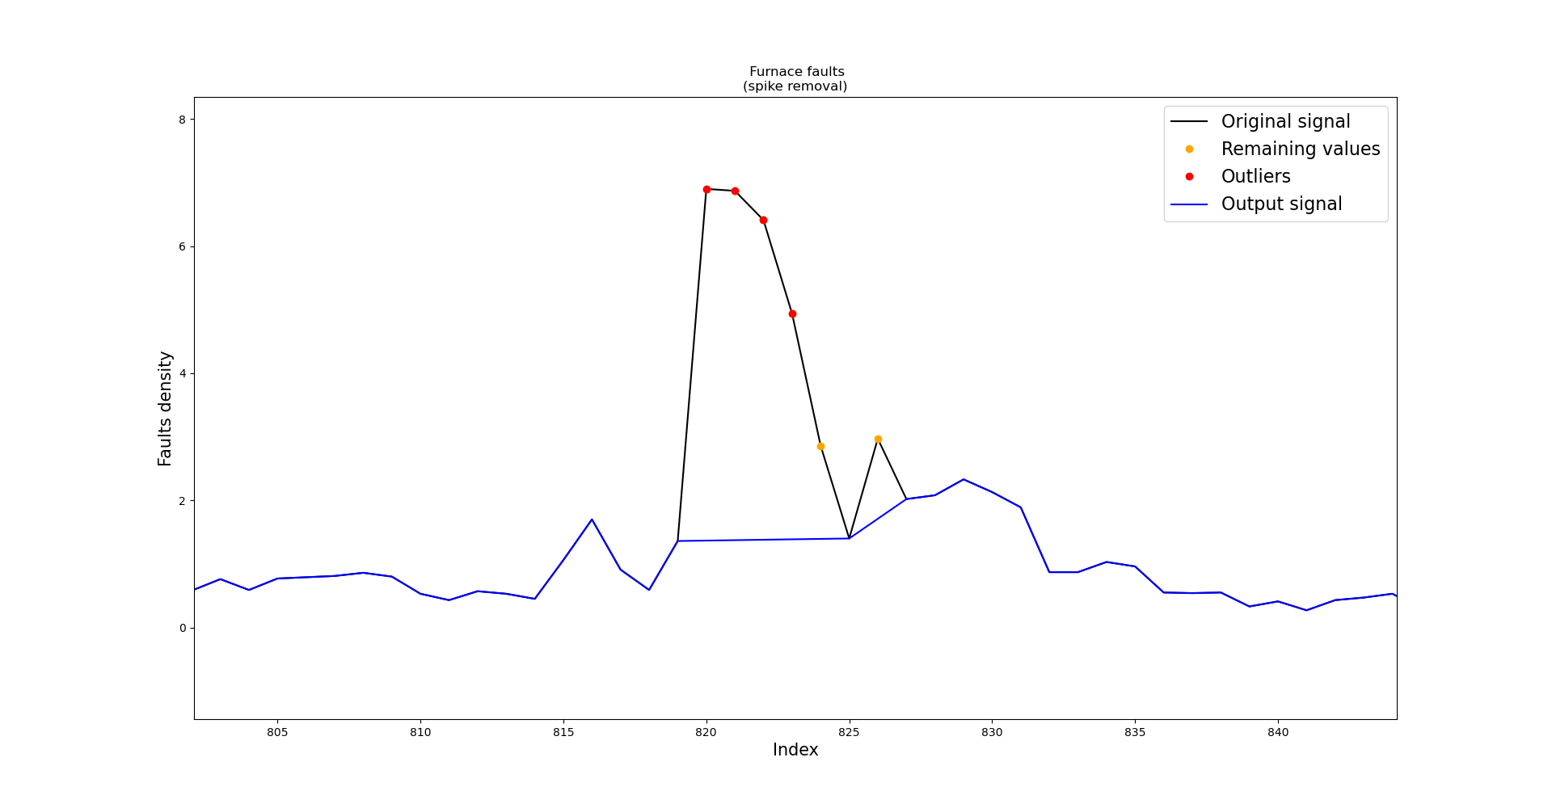
Region 1: High-pass filter, spike definition and remaining values definition

Slide 15
Removal of the potential remaining data from the spikes
When using the data corresponding to the period from ‘21/09/19’ to ‘25/10/19’.
When using the data corresponding to the period from ‘07/03/2020’ to ‘19/03/2020’.

Slide 16
Continuous clean regions: ISRA 5D
Clean regions
ISRA 5D

Slide 17
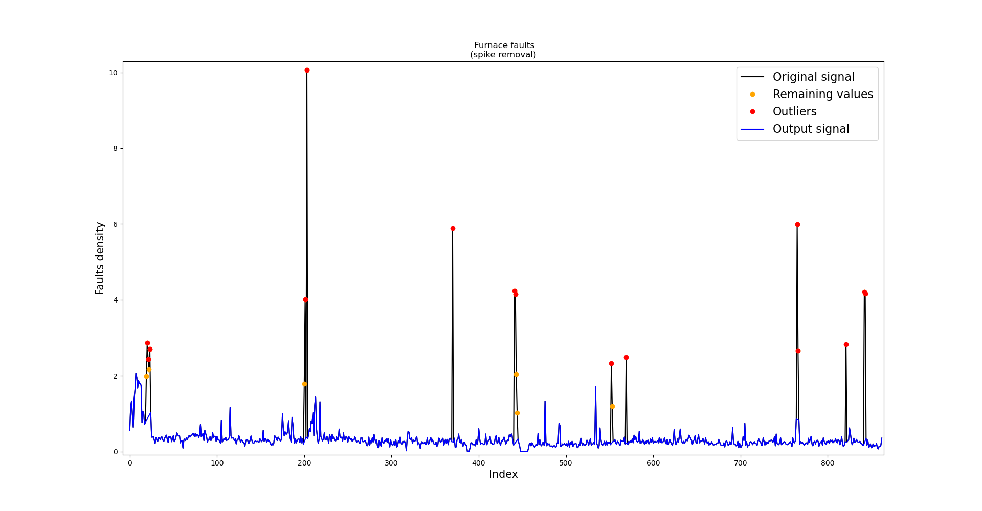
Region 2: High-pass filter, spike definition and remaining values definition

Slide 18
Region 2: High-pass filter, spike definition and remaining values definition
Zoom in

Slide 19
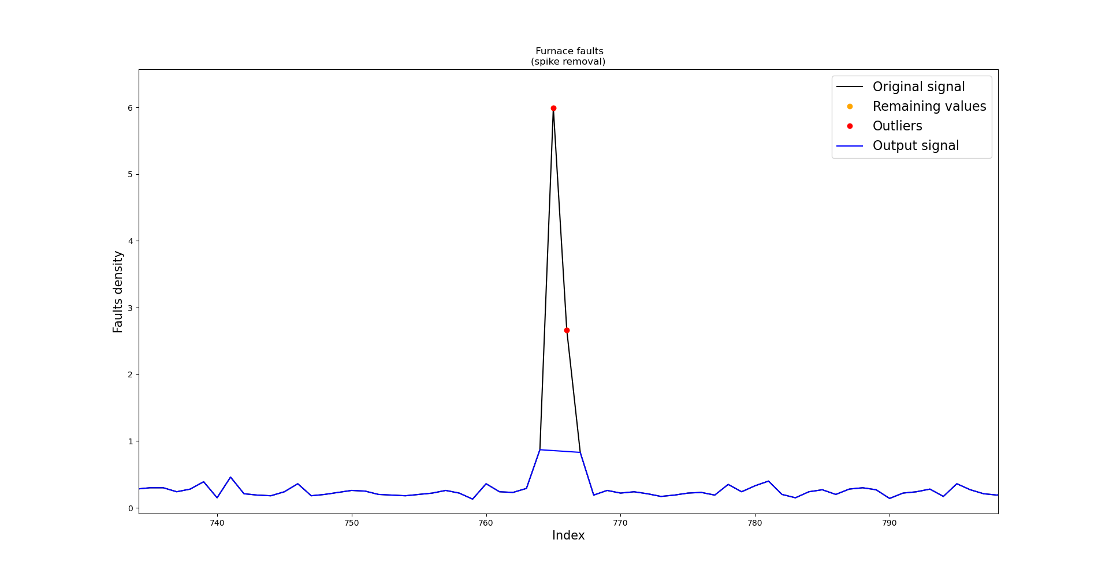
Region 2: High-pass filter, spike definition and remaining values definition

Slide 20
List of activities
Implementation of the strategy to remove the remaining data from the spikes in the Remove Spikes pipeline section.
Test the strategy in both available training datasets.
Introduce Bespoke filtering.
How the relevant inputs change along with the training dataset?
Eliminate the relevant inputs that are correlated and run the model again.

Slide 21
Bespoke filtering
Once the most relevant inputs have been identified, we put emphasis on their conditioning process.
For instance, if a relevant input have been conditioned with a low-pass filter, then we revise the filter parameters.

Slide 23
Tune low-pass filter parameters

Slide 24
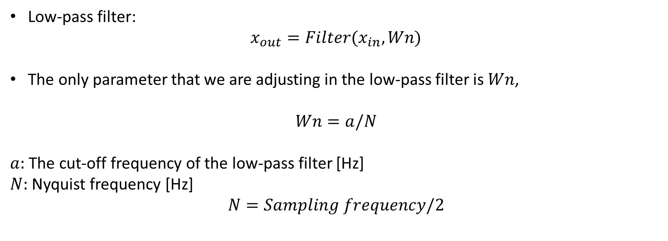
Adjusting low-pass filter parameters
Low-pass filter:
$$x_{out}=Filter(x_{in},Wn)$$
The only parameter that we are adjusting in the low-pass filter is $Wn$,
$$Wn=a/N$$
$a:$ The cut-off frequency of the low-pass filter [Hz]
$N:$ Nyquist frequency [Hz]
$$N=Sampling frequency/2$$

Slide 25
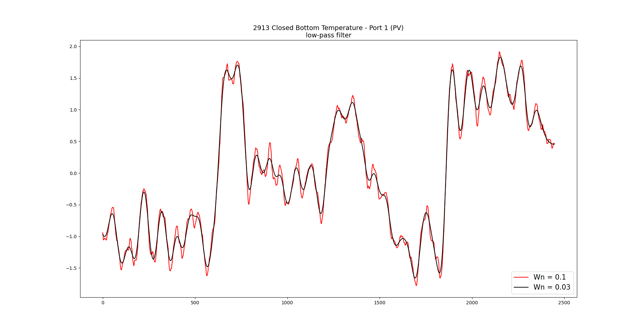
Adjusting low-pass filter parameters

Slide 26
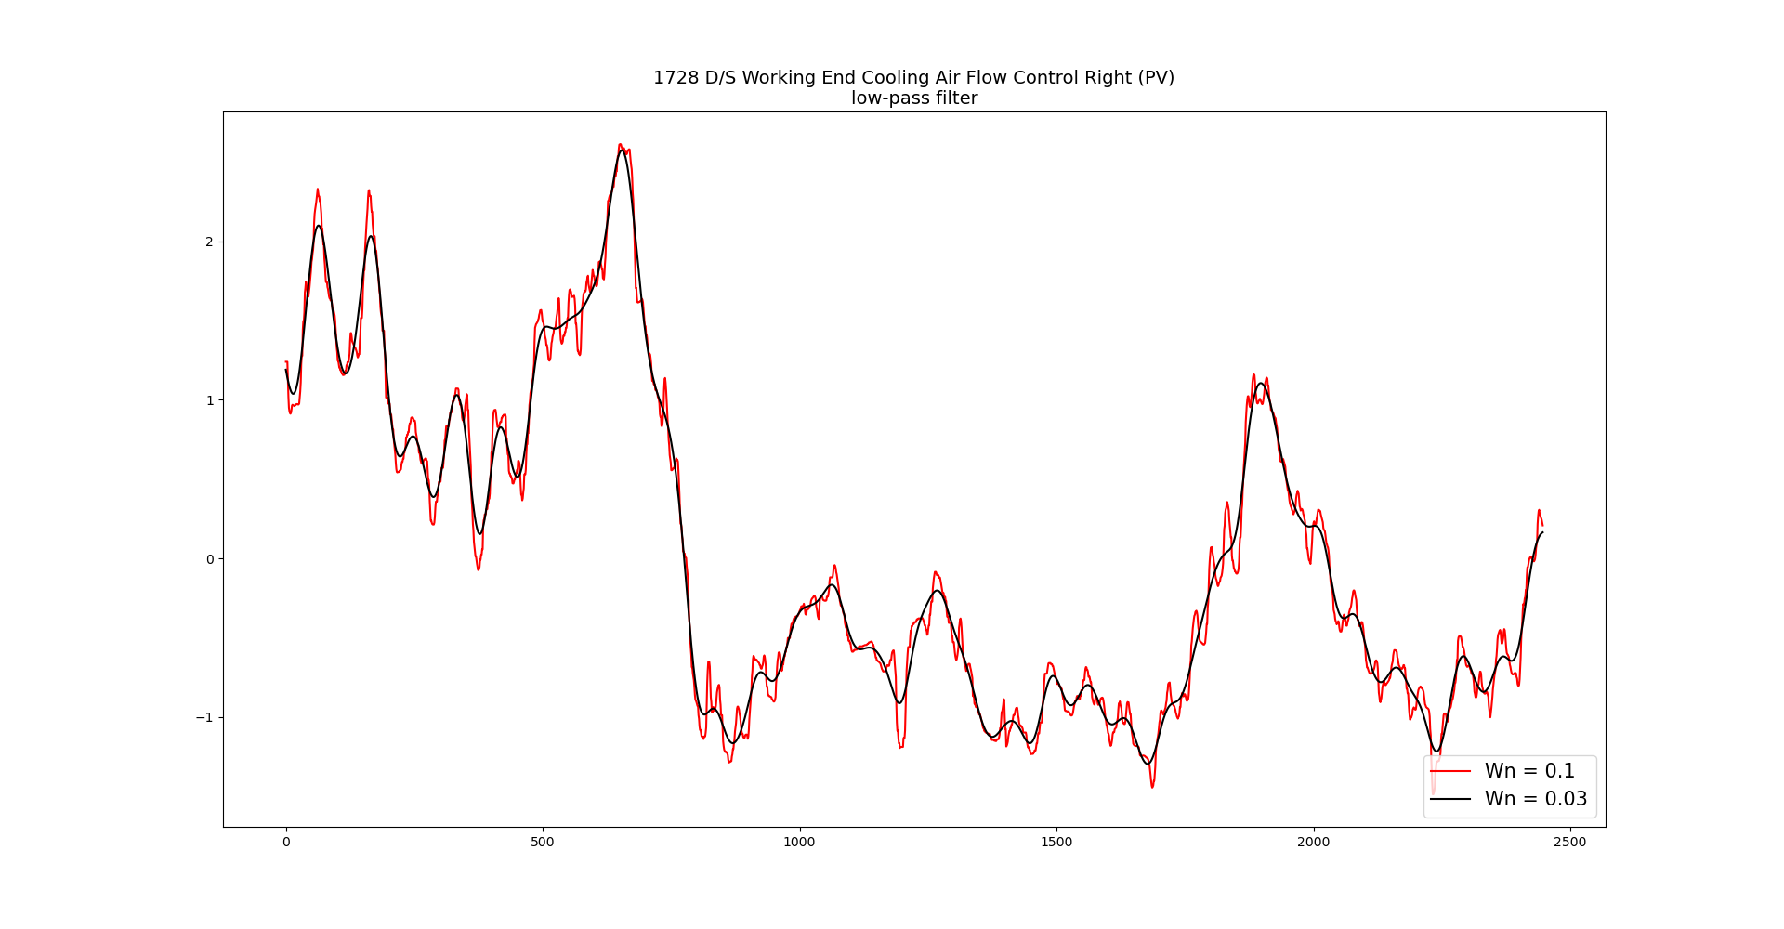
Adjusting low-pass filter parameters

Slide 27
List of activities
Implementation of the strategy to remove the remaining data from the spikes in the Remove Spikes pipeline section.
Test the strategy in both available training datasets.
Introduce Bespoke filtering.
How the relevant inputs change along with the training dataset?
Eliminate the relevant inputs that are correlated and run the model again.

Slide 28
Case 1: Data from the first region is used for training
Clean regions
ISRA 5D
Training
Testing

Slide 29
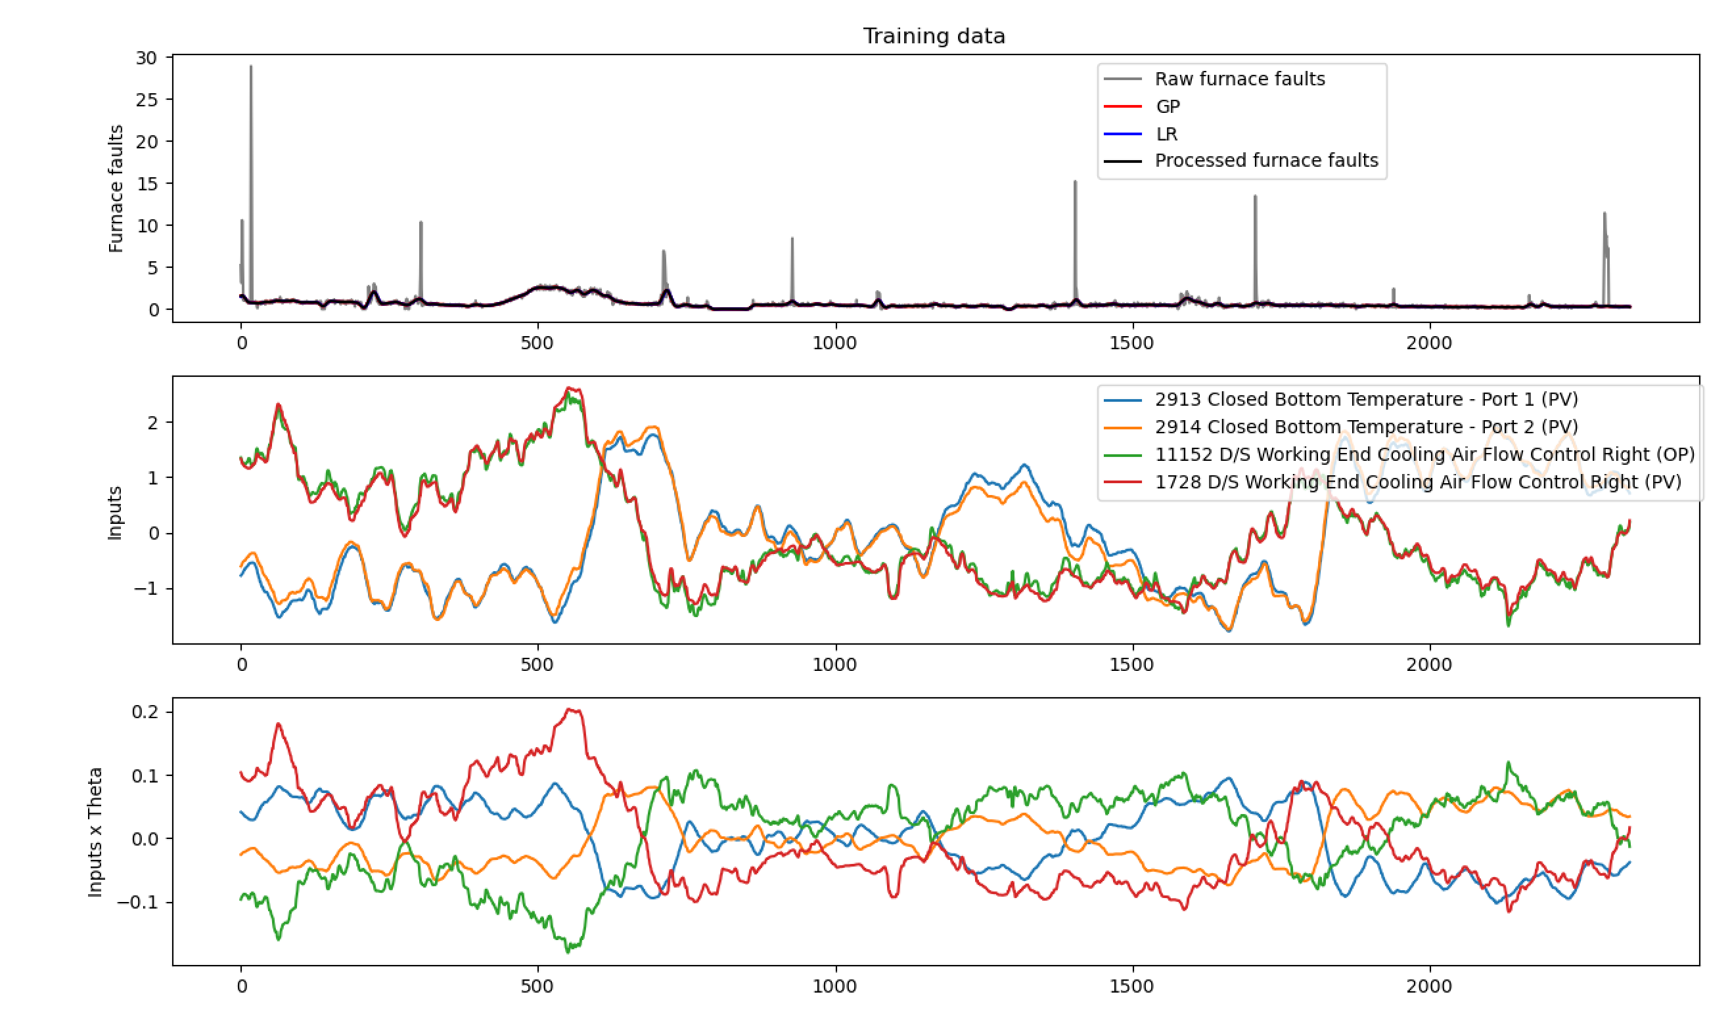

Slide 30
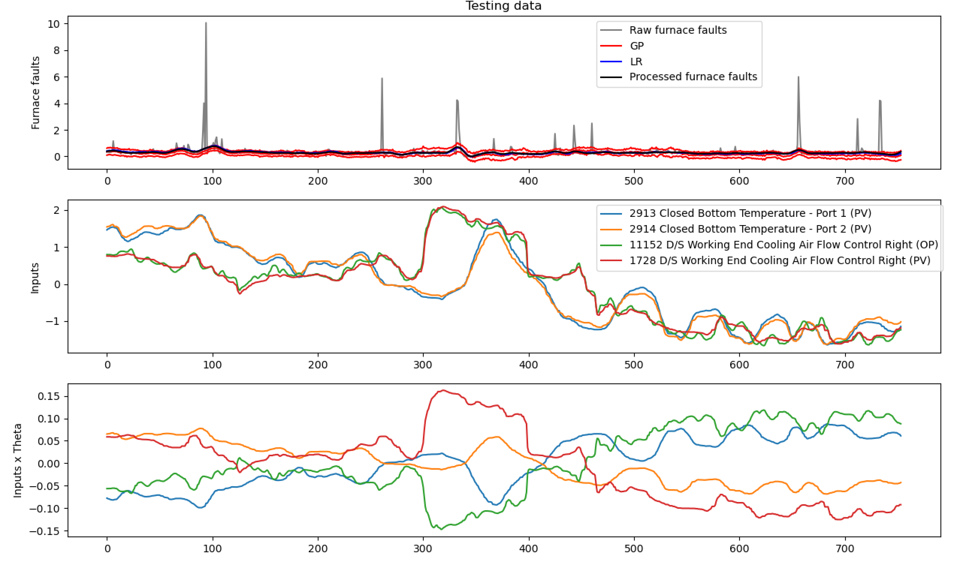

Slide 31
Case 2: Data from the second region is used for training
Clean regions
ISRA 5D
Testing
Training

Slide 32
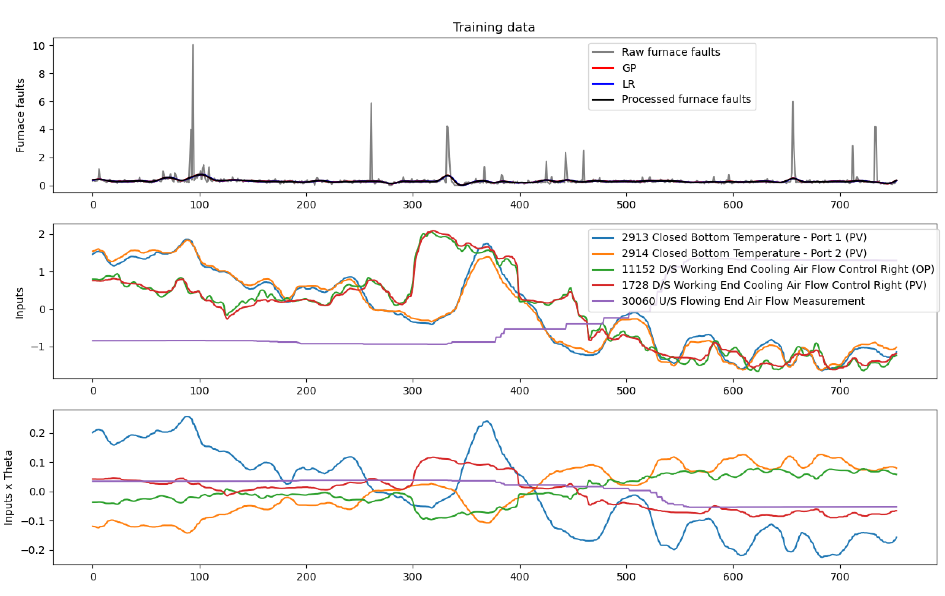

Slide 33
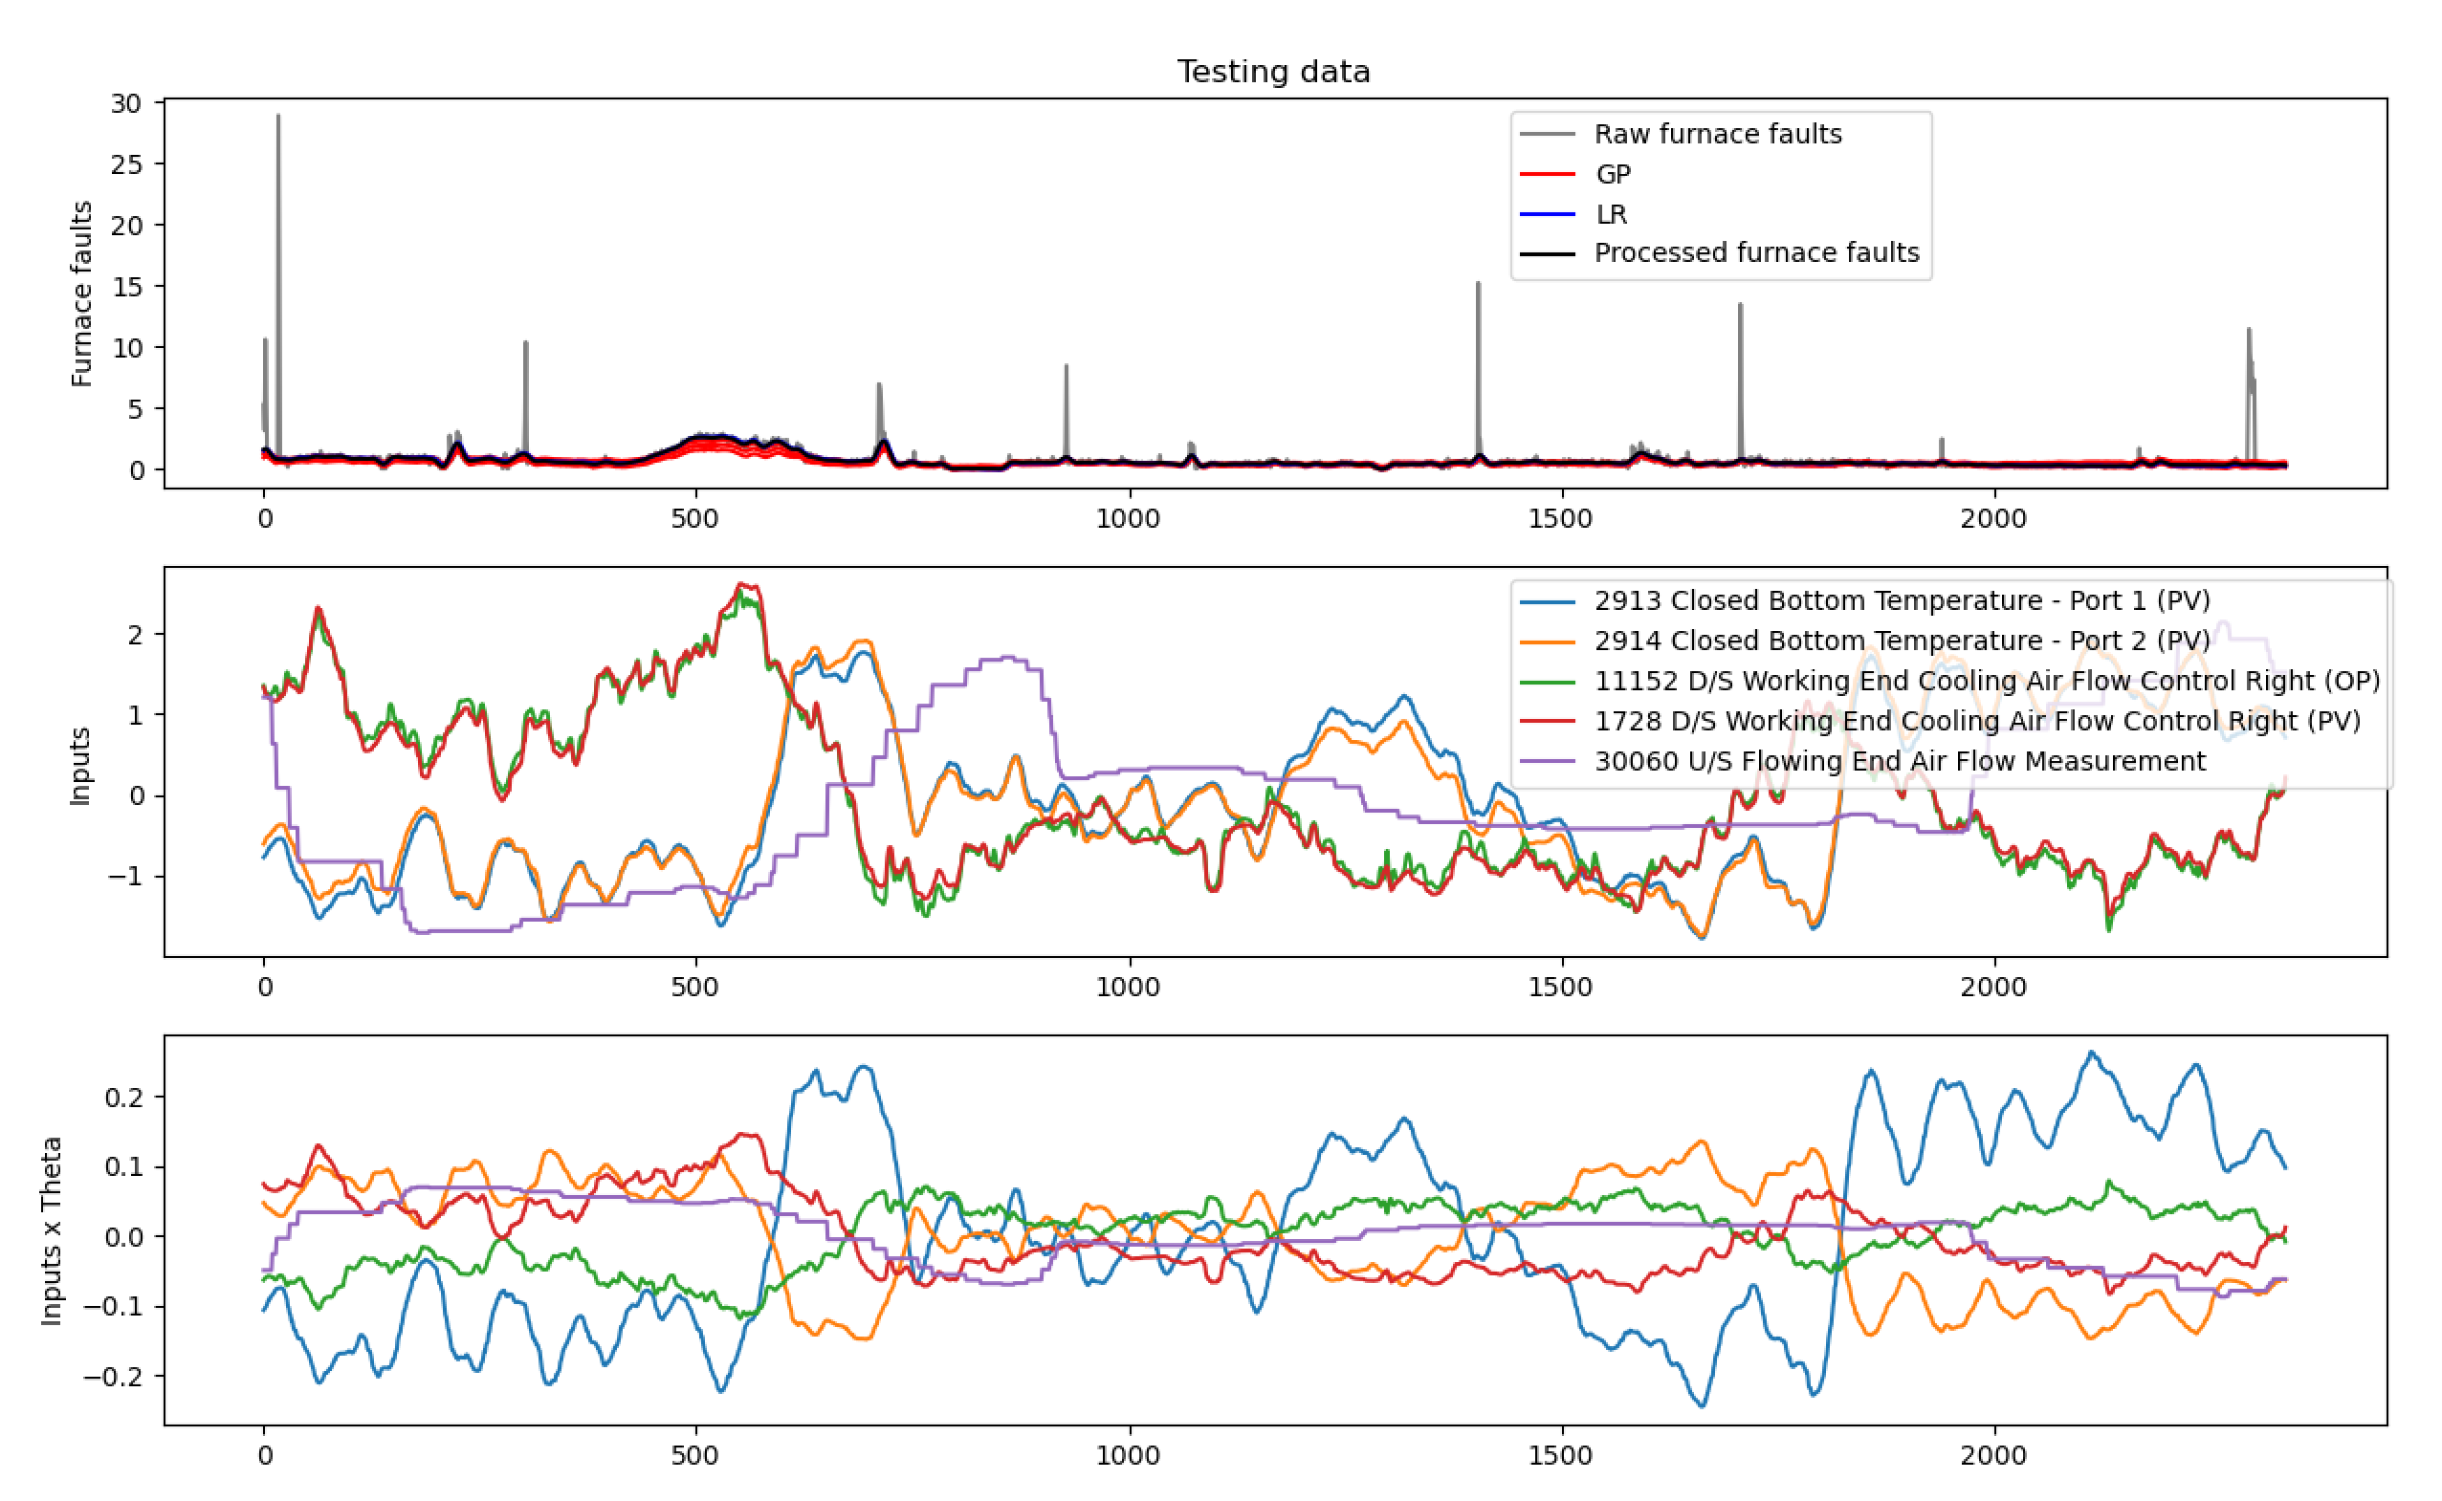

Slide 34
List of activities
Implementation of the strategy to remove the remaining data from the spikes in the Remove Spikes pipeline section.
Test the strategy in both available training datasets.
Introduce Bespoke filtering.
How the relevant inputs change along with the training dataset?
Eliminate the relevant inputs that are correlated and run the model again.

Slide 35
Remove correlated tags
Experiment: we will remove (only)
Closed Bottom Temperature - Port 1 (PV)
D/S Working End Cooling Air Flow Control Right (OP)
and see what happens.
Wider question: should we go back to removing correlated inputs?
Does not appear to be causing numerical issues
Potentially harming interpretability

Slide 36
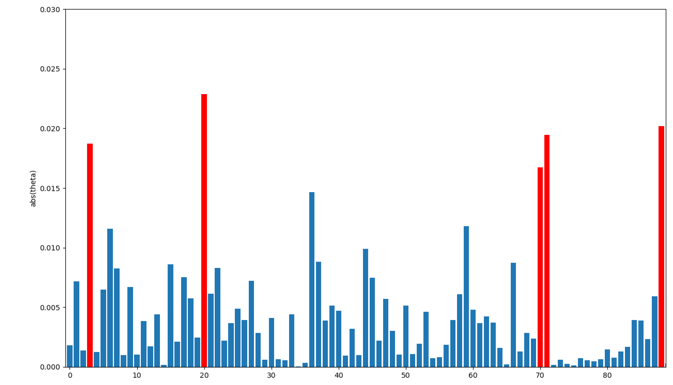
New relevant tags have been identified

Slide 37
How the new relevant tags change for case 1?
Clean regions
ISRA 5D
Training
Testing

Slide 38
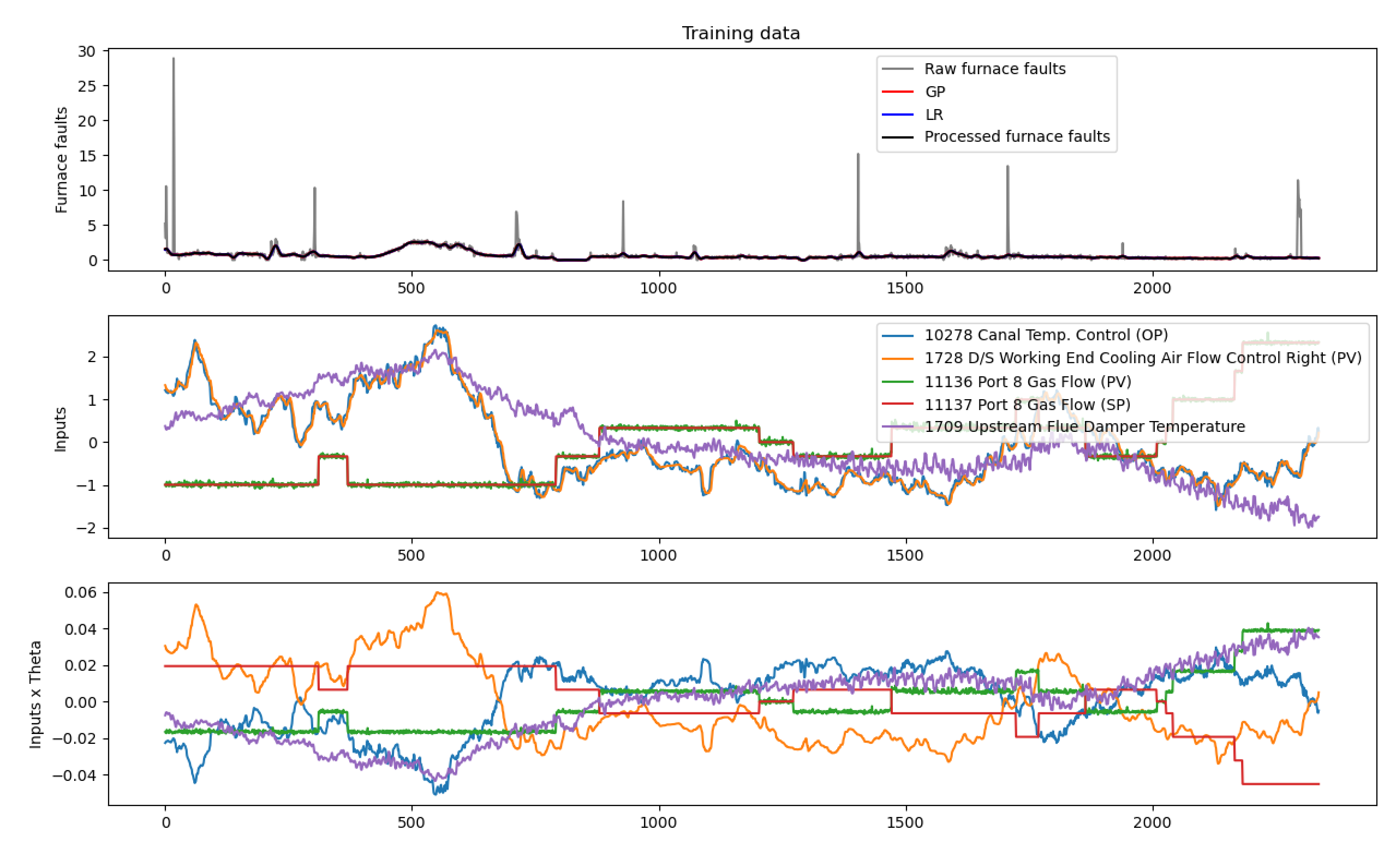

Slide 39
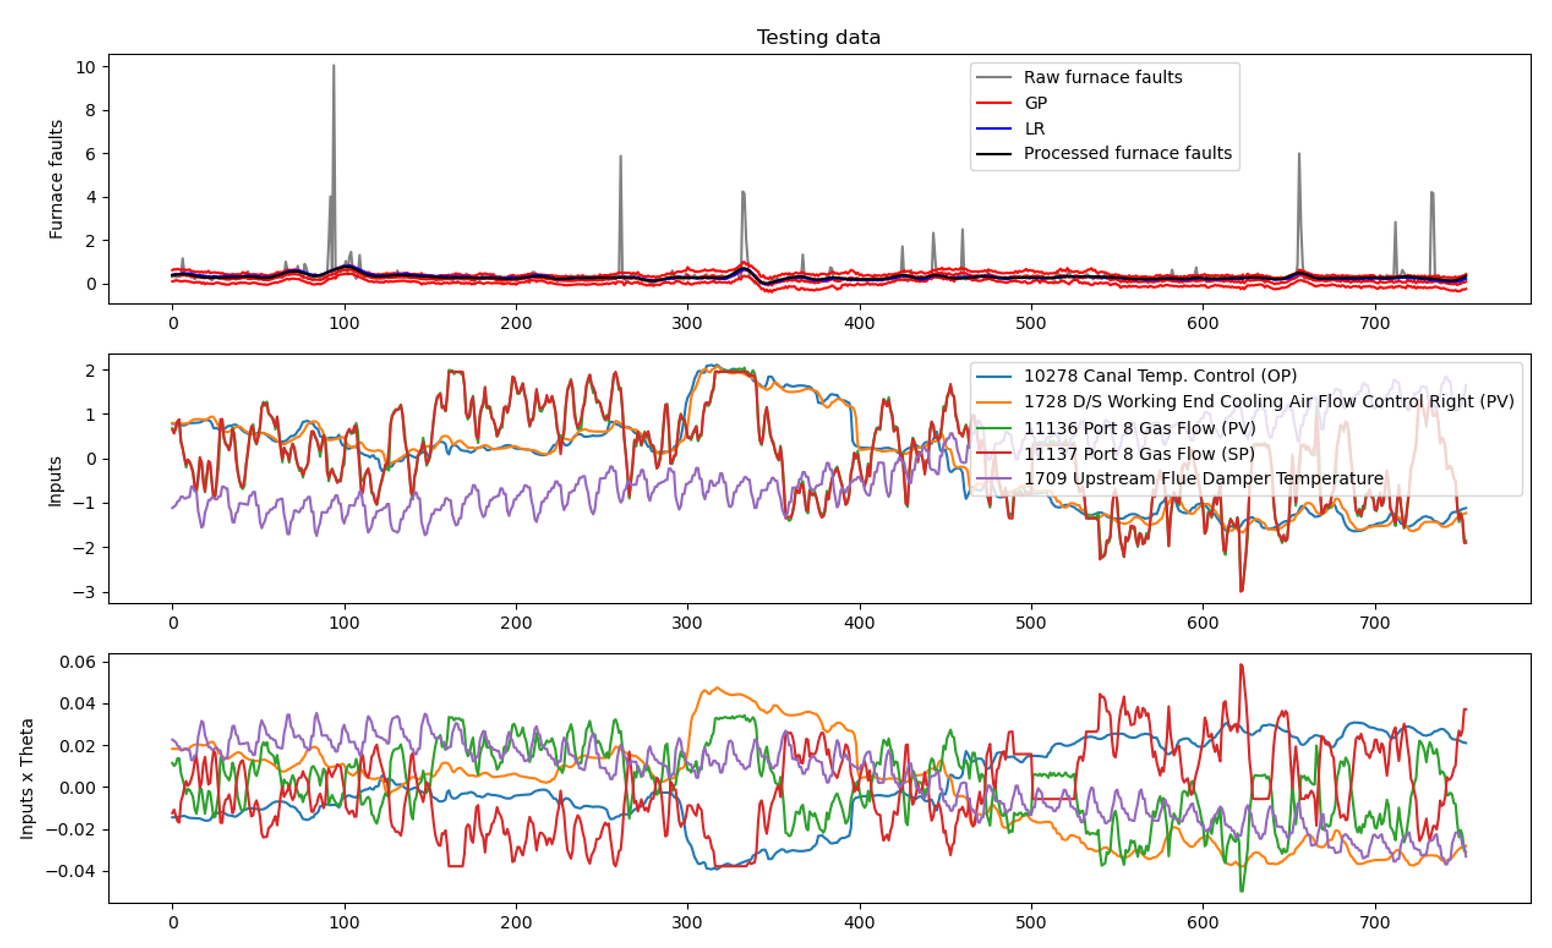

Slide 40
Next activities
The test of the Remove Spikes pre-processing box have shown that we have to account for more scenarios, and hence, further work needs to be done in this box (more programming time).
To use the uncorrelated inputs provided by the team to avoid identifying relevant tags that will cancel out.
Bespoke filtering after identifying relevant inputs using the uncorrelated tags.
Change the time lags randomly.

Slide 41
Thank you for your attention. ANY QUESTIONS?

